Slide 1
Assembly Code Preface
许珈铭
2023.9.27

Slide 2
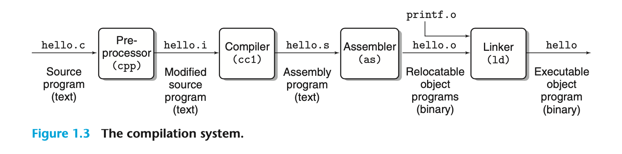
C/C++编译
Pre-processor
Compiler
Assembler
Linker&loader

Slide 3
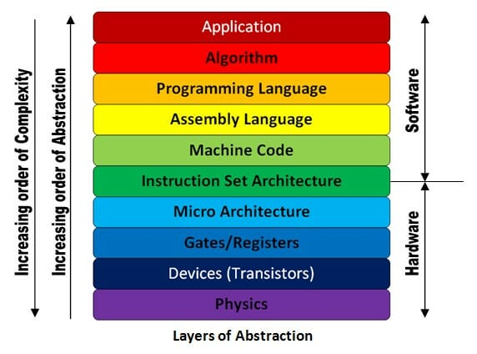
Recall
C/C++ (.c/.cpp, .h/.hpp)
Java
GCC
↓Compiler
Assembly language (.s)
↓Assembler
Machine Code (.o, .so, .a)
↓Linker
CLANG (LLVM)
↓Compiler
LLVM IR
↓LLVM Optimizer
LLVM Backend
↓Assembler
↓Linker
JVM
↓Compiler
Java Bytecode
(Java Virtual Machine)
↓Assembler
↓Linker
Machine Code
JIT
↓Compiler
Java Bytecode
↓Just In Time compiler
Machine code
(Java Virtual Machine)
↓Linker
Machine Code

Slide 4
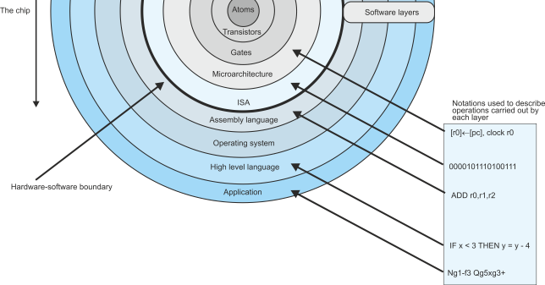
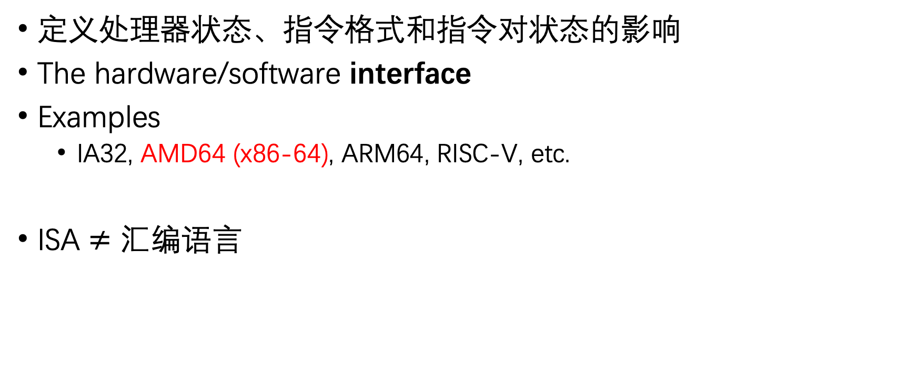
Two abstractions: ISA
定义处理器状态、指令格式和指令对状态的影响
The hardware/software interface
Examples
IA32, AMD64 (x86-64), ARM64, RISC-V, etc.
ISA $≠$ 汇编语言

Slide 5
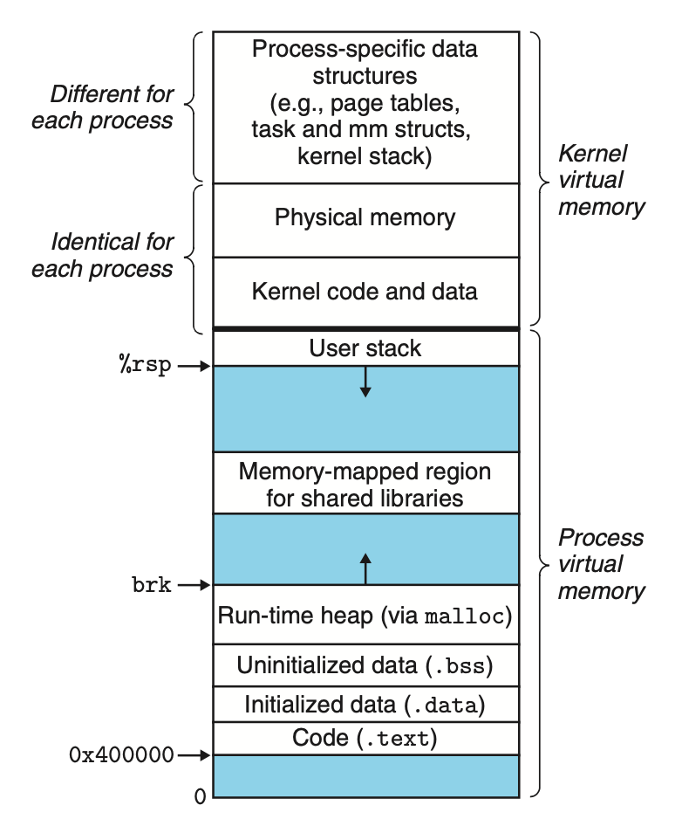
Two abstractions: Virtual Address
每个 进程 享有同样的虚拟地址空间
操作系统的四大抽象之一，随着ICS的学习会逐渐补全拼图

Slide 6


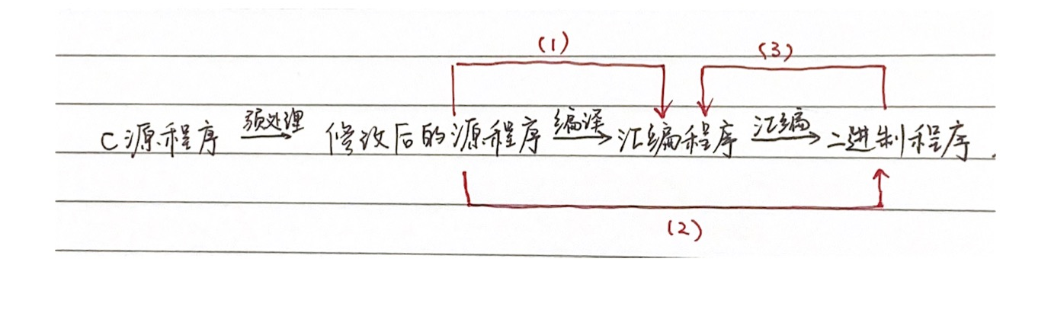
工具链
(1) gcc [-O] -S <file> [-o]
(2) gcc [-O] -c <file> [-o]
(3) objdump -d <file> (> ...)
·gdb and bomblab
(c->s) Compiler Explorer
(o->c) ByteNinja

Slide 7
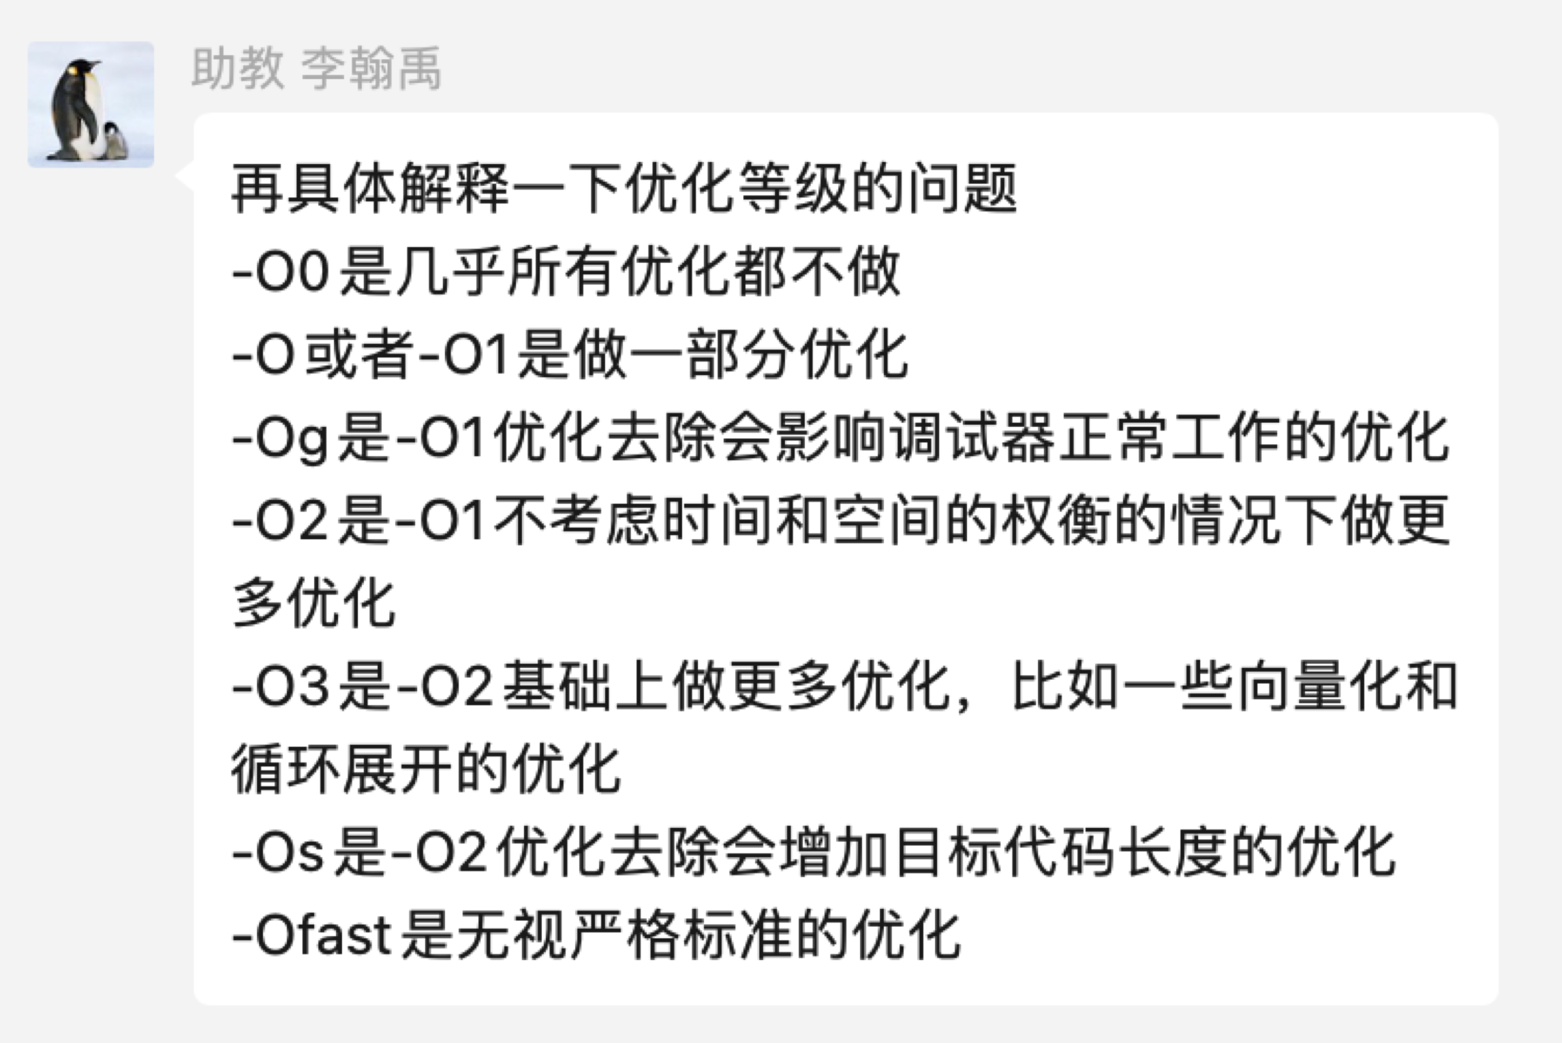
编译器优化

